Slide 1
Task 01
Insights from British Airways Customer Reviews Analysis
BENZAHRA Karima

Slide 2


Introduction
As the data scientist leading this project, our goal is simple: to transform customer feedback into actionable insights. By analyzing reviews from Skytrax, we aim to uncover key trends and sentiments that will drive business decisions and enhance the travel experience for our passengers. Join us on this journey as we dive into the data and uncover valuable insights that will shape the future of British Airways.

Slide 3
Sentiment Distribution
Sentiment Analysis Insights:
Positive: 568 instances
Negative: 420 instances
Neutral: 12 instances
Majority of reviews are positive, indicating overall satisfaction with British Airways.
Negative reviews are notable but represent a smaller proportion compared to positive reviews.
Neutral reviews are minimal, suggesting clear sentiments expressed by customers.

Slide 4
Topic Modelling Results
Based on the topics generated by the LDA model, here are the main themes or ‘topics’ :
Topic 1: Seat and Time
- Keywords: seat, time, service, class, make, British, get, book, one, fly
Topic 2: British Airways Service
- Keywords: British, US, Airways, get, seat, service, one, fly, staff, hours
Topic 3: Service and Flying Experience
- Keywords: seat, service, fly, time, London, hours, get, one, first, customer
Topic 4: Service Quality
- Keywords: get, seat, would, service, call, crew, London, fly, food, good
Topic 5: Business Class Experience
- Keywords: seat, service, time, board, business, class, get, crew, food, good

Slide 5
Topic-Sentiment Analysis
British Airways Service:
More positive than negative reviews, indicating overall satisfaction with services.
Business Class Experience:
Substantial positive feedback suggests high satisfaction with business class amenities.
Seat and Time:
Generally positive sentiment regarding seating arrangements and punctuality.
Service Quality:
Slight imbalance with slightly more negative reviews, indicating areas for improvement in service quality.
Service and Flying Experience:
More negative than positive reviews, highlighting areas needing attention for enhancing the flying experience.
In summary, while British Airways excels in certain areas, there are opportunities for improvement in service quality and the overall flying experience to ensure continued customer satisfaction.

Slide 6
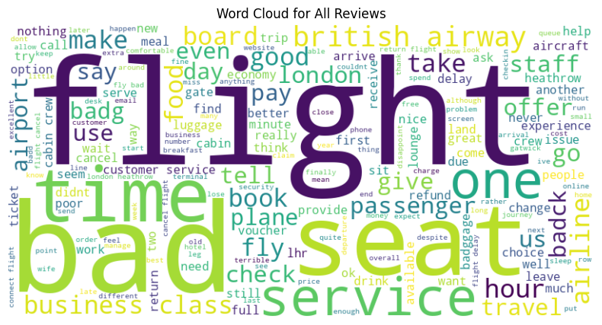
Word Clouds
Visualizing the collective voice of our customers, the word cloud encapsulates the essence of their feedback, revealing recurring themes and sentiments. Each word represents a unique perspective, contributing to our understanding of the customer experience.

